Slide 1
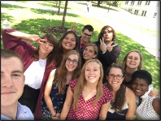
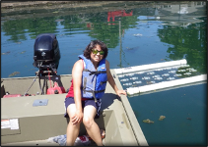
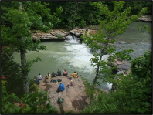
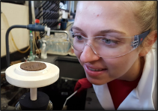
Research Experience for Undergraduates (EcoREU)
Assessment and Sustainable Management of Ecosystem Services
at the Nexus of FOOD, ENERGY, and WATER
May 18-July 20, 2025
The EcoREU program explores the concept of sustainable management of ecosystems across cultures with a particular focus on Native American culture. Research projects provide a transdisciplinary approach to ecosystem assessment and sustainability.
What’s the focus: water quality, sustainability, biofuels, and other topics related to the environment
How much does it pay: students will receive $7,000 stipend, $1,000 food supplement over the course of the 10 weeks. Student travel will be covered by the program and they may choose to receive free university housing or upto $1,700 in housing support.
Who should apply: undergraduate students who want to get research experience
Native Americans and students from other underrepresented groups in STEM are encouraged to apply
Application link
Deadline:
January 15, 2025
Program dates:
May 18 - July 20, 2025
Need more info:
email ecoreu@uark.edu

